Slide 1
Money Laundering Classification
Submitted by: A.Shrikant

Slide 2
Problem Statement
In many parts of Africa mobile money transactions are used for sending and receiving money.
We have synthetic financial services dataset generated by a simulator called PaySim. PaySim generates datasets similar to real datasets from mobile money transactions.
Our objective is to use this PaySim dataset and build a classification model to detect fraud/money laundering activities.

Slide 3
Approach:
1. Data Preprocessing:
Shape of dataset: (6362620, 11)
No duplicates found.
No missing values found.

Slide 4
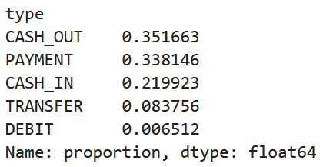
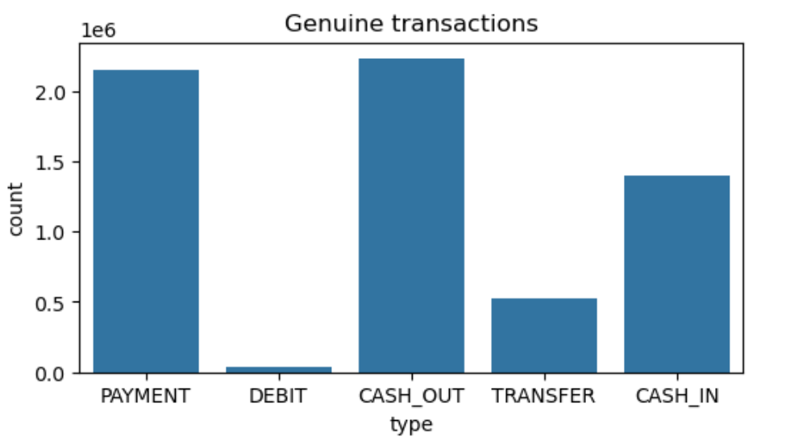
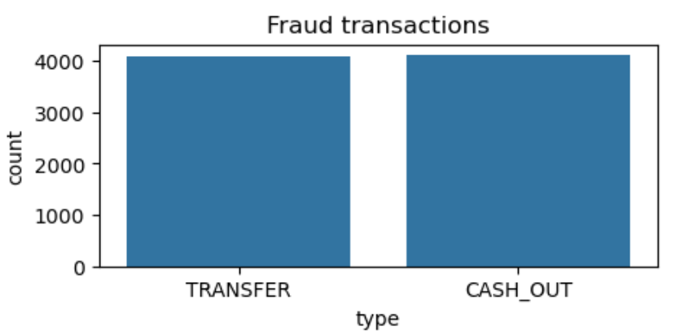
2. Exploratory Data Analysis:
Analyzing the ‘type’ variable:

Slide 5
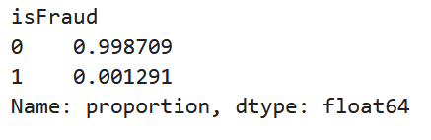
Analyzing the ‘isFraud’ variable:
Analyzing transactions using variables 'nameOrig' and 'nameDest':
2/3 of the transactions are CC_T and 1/3 are CM_T.
All the fraud cases mentioned in the dataset occurred in CC_T and no fraud occurred in CM_T.

Slide 6
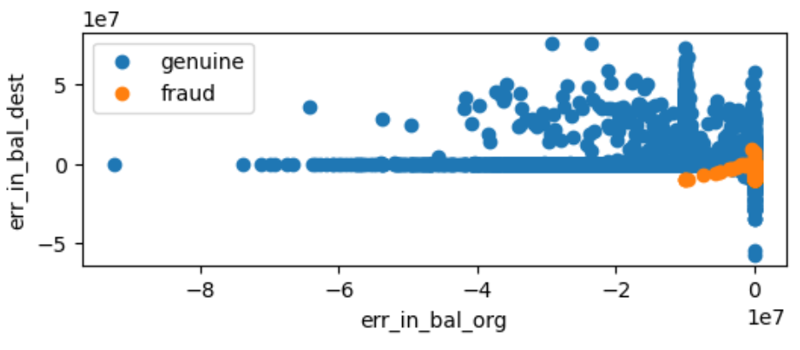
Analyzing the balance of both sender's and recipient's account:
The simulation is not taking into account of the data integrity constraint i.e. in the dataset the rule amount deducted must be equal to amount added is not followed.

Slide 7
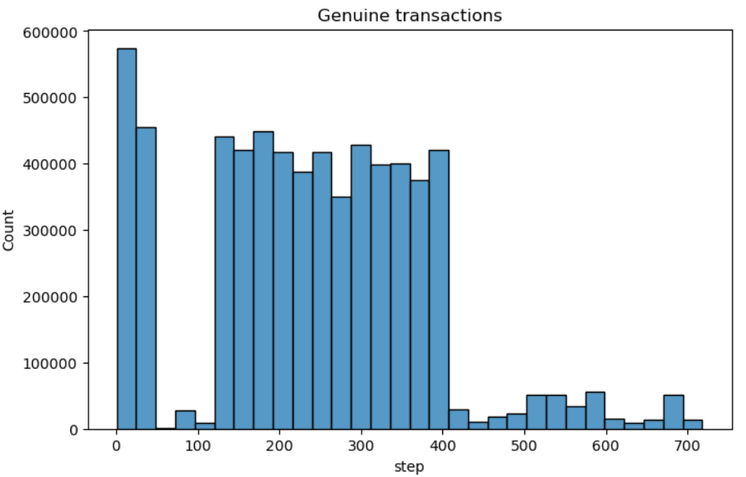
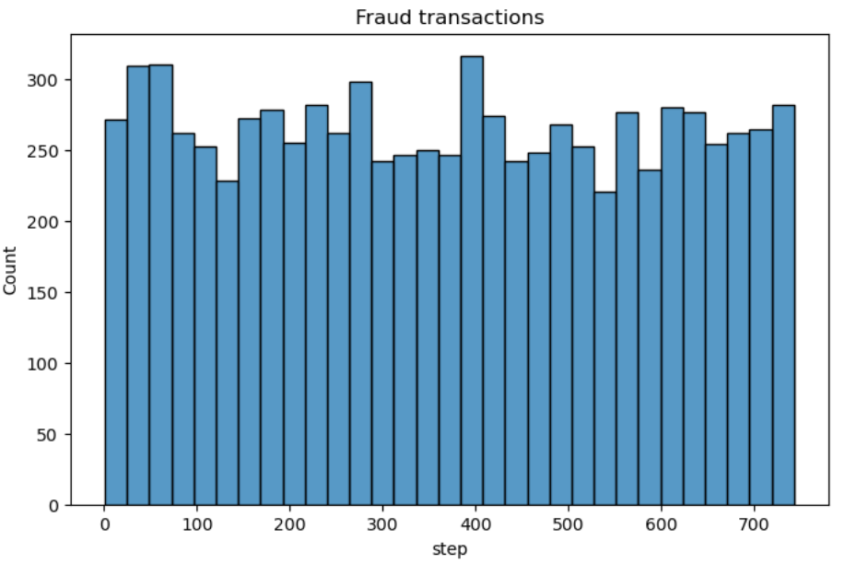
Analyzing the ‘step’ variable:
Most of the genuine transactions are done on days 1-2 and days 6-17 of the month. Whereas the fraud transactions are done uniformly across all days of the month.

Slide 8
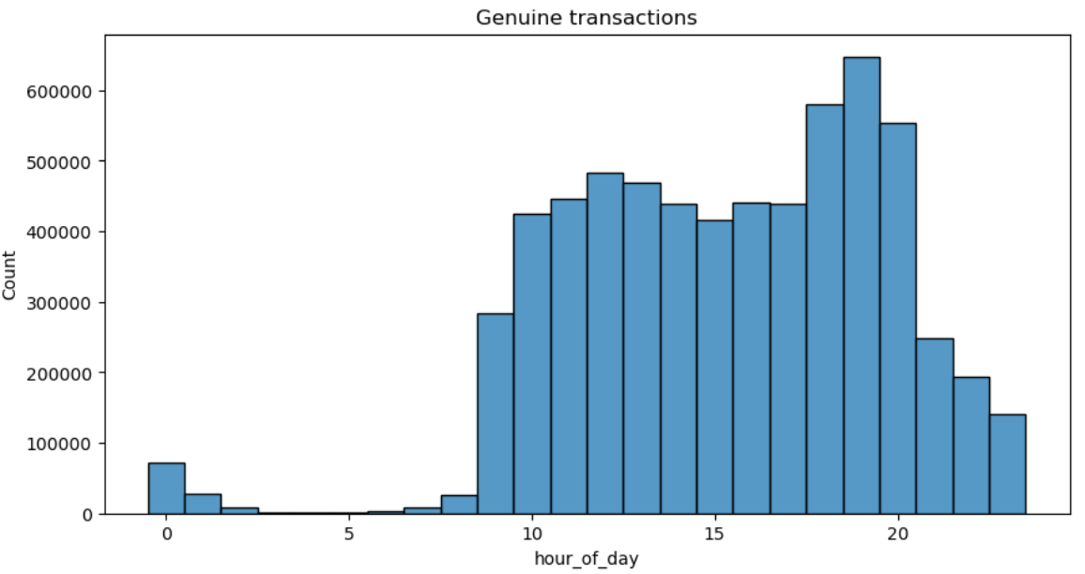
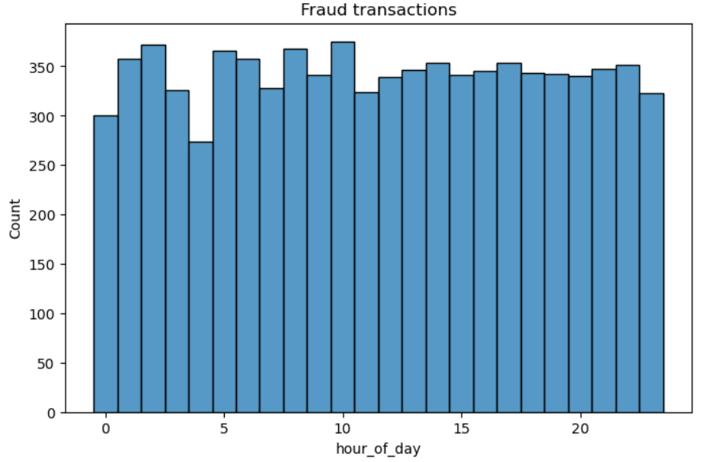
Analyzing the ‘hour_of_day’:
Most of the genuine transactions are done on hour of the day 9-23. Whereas the fraud transactions are done uniformly across all hours of the day.

Slide 9
3. Dropped the following columns.
'nameOrig', 'nameDest', 'isFlaggedFraud‘, 'step‘
'nameOrig', 'nameDest', contain id of the sender who initiated the transaction
and the recepient of the transaction.
'isFlaggedFraud' purpose is not clear because it does not adhere to the rule
that the meta data says for it.
4. Created ’hour_of_day’ column using the ‘step’.
5. Applied One Hot Encoding for the ‘type’ column.

Slide 10
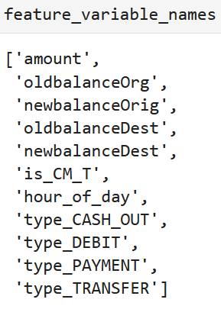
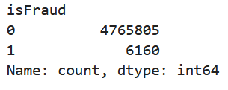
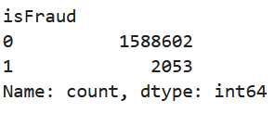
6. Separated the dependent and independent variables.
7. Splitting the data into train and test:
test_size=0.25
train data: test data:

Slide 11
8. Apply SMOTE on the train data set to treat data imbalance because when using Supervised ML algorithms data imbalance would cause the model to be heavily biased towards majority class.
9. Applied Feature Scaling on numeric columns:
['amount', 'oldbalanceOrg', 'newbalanceOrig', 'oldbalanceDest', 'newbalanceDest', 'hour_of_day']

Slide 12
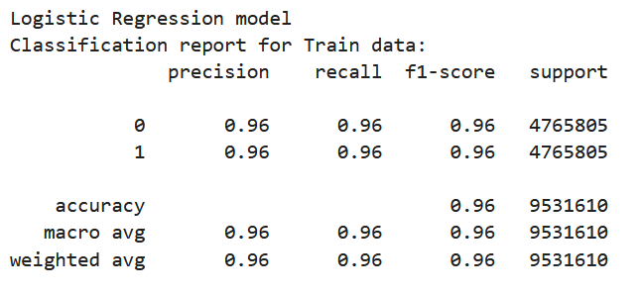
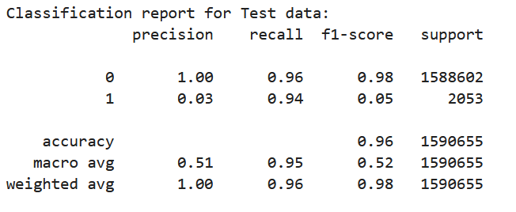
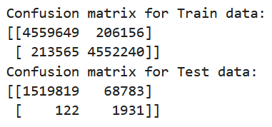
10. Model Building:
Building the Logistic Regression model:

Slide 13
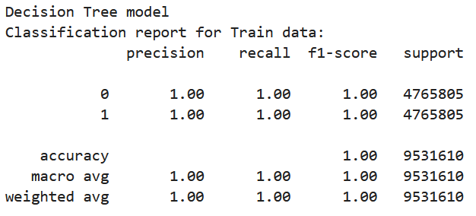
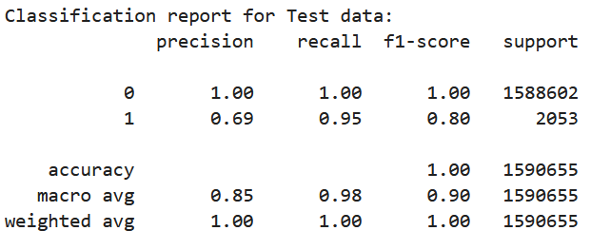
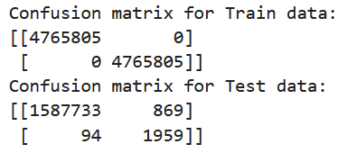
Building the Decision Tree model:

Slide 14
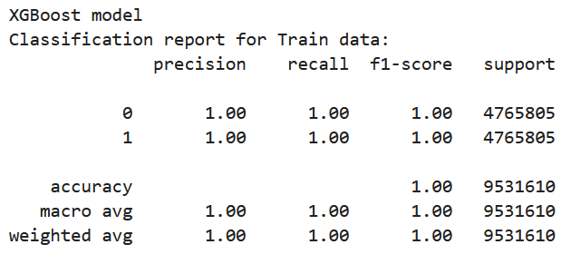
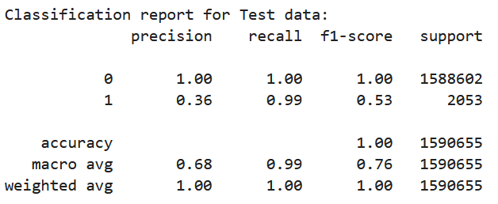
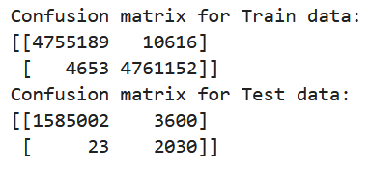
Building the XGBoost model:

Slide 15
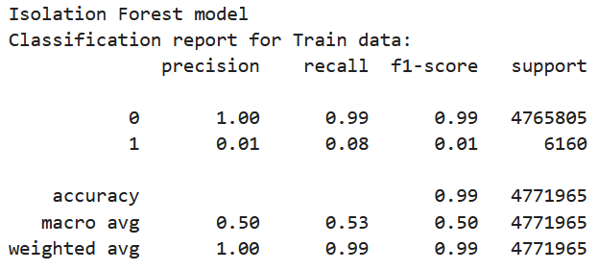
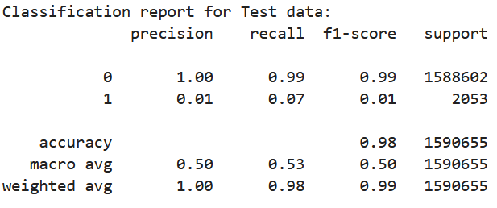
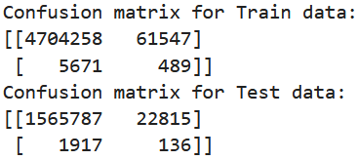
Building the Isolation Forest model:

Slide 16
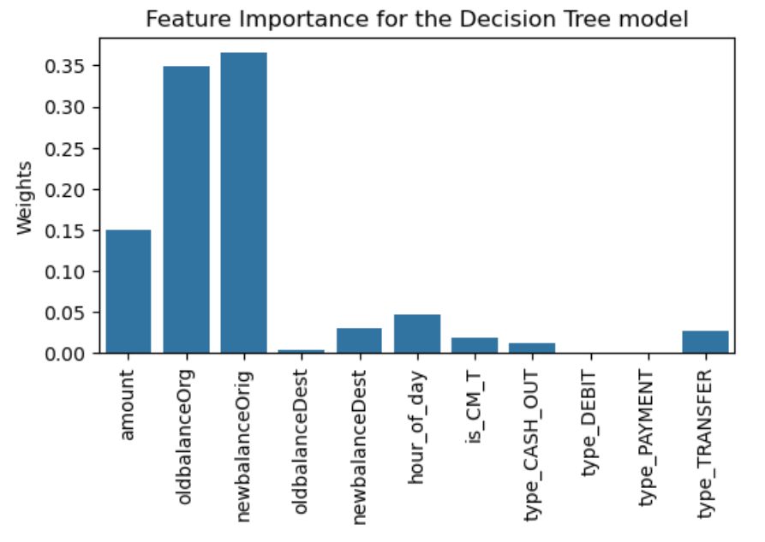

Slide 17
11. Conclusion:
The Decision Tree model is best suited for this task of detecting transactions involving Money Laundering because it has the least False Positives among all the tried models and a very good precision and recall for the positive and negative class in both train and test dataset.
Thank You

